Slide 1


TOXIC
FEMININITY
The death mother wields a fierce, violent and corrosive power, rampant in our society now. When the death mother (Medusa) penetrates both the psyche and body, we are turned to a stone which kills all hope and cuts us deep into chthonic darkness. The child yearns for the oblivion of death, turning inward and against oneself and their body. The destruction is harder to bear when it comes from somebody we love and trust, our beloved mother.

Slide 2


Where we are no longer acceptable as an innocent child , some part of us dies. If we challenge or confront our mother, the nervous system becomes hypervigilant and anxious , resulting in fears of abandonment or engulfment. We will try to destroy anything that may facilitate change or confrontation , where we can return to the maternal womb of safety and protection
The neglectful mother cuts off any ability for metaphoric and symbolic thinking as we are denied access to the archetypal world, only seen through infantile toxic and distorted images and reasoning.
HYPERVIGILANCE

Slide 3
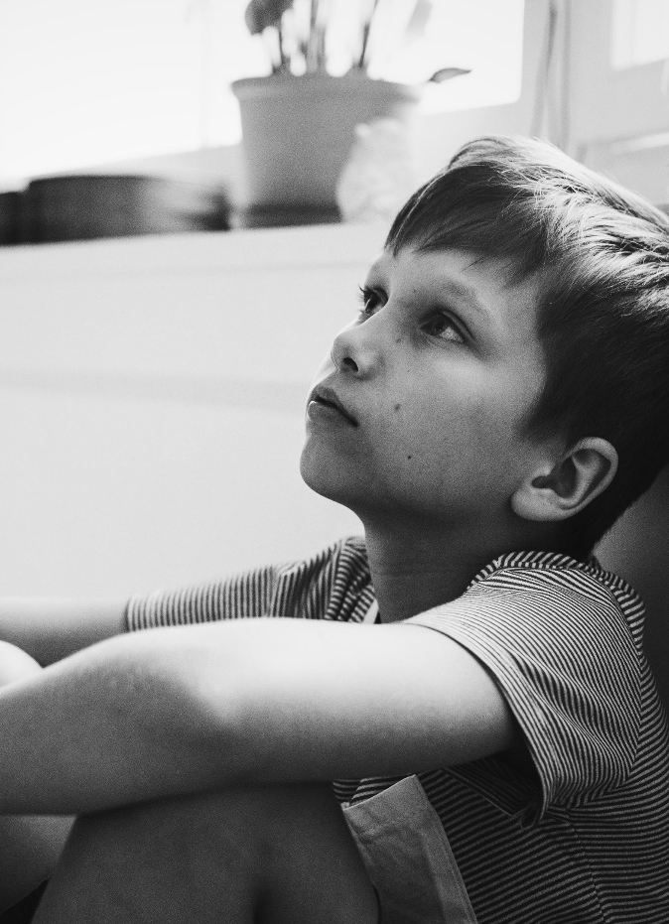
INNER TYRANT
The child ends up with an overwhelming desire to please others, pleasing those who can unconsciously manipulate them. The absent mother is intertwined with the victim, exasperating a cycle of hopelessness and despair, imprisoned by neurotic suffering. As long as we are blind to the inner tyrant, we will continue to blame the outer tyrant, a person, political system or our own body. In the journey of healing, we work towards healing the wounds of our hearts, as we have the courage to face the darkness and ourselves.

Slide 4

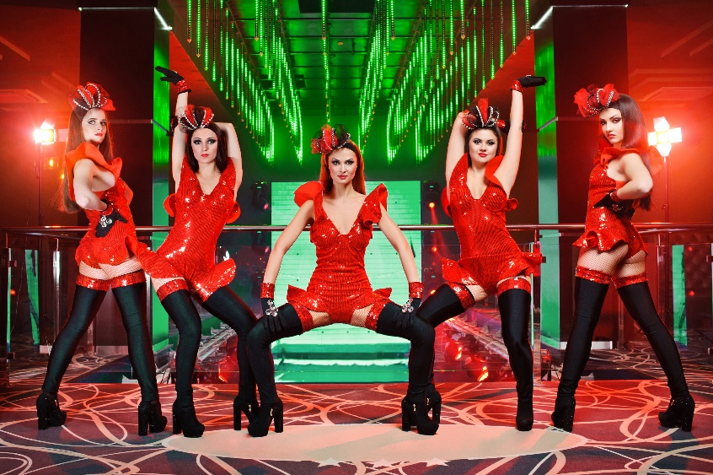
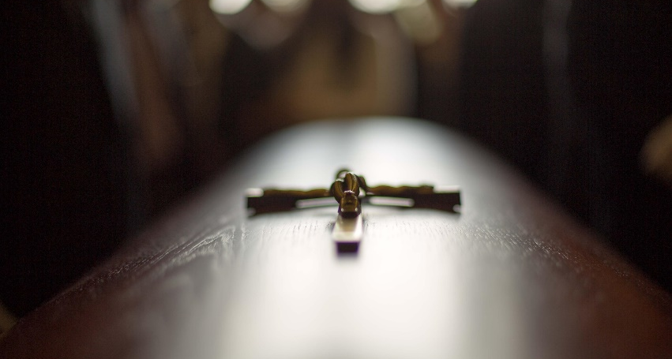
PSYCHOLOGICAL DEATH
We need to be ready to confront our mother; we need to embrace and integrate our authentic feelings, with a willful ,disciplined spirit of vibrance and creativity. The death of the psychological mother can be excruciating , but needed to instigate change, the death of values and beliefs rooted in fear and power. A lived examined life is constantly burning away the veils of illusions, gradually revealing the essence of who you are. Be willing to face cruel truths; we must die to a false image, false relationships and false faiths, and change our outer life.

Slide 5
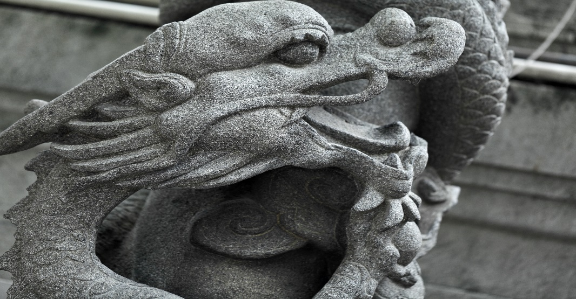

SEDUCTIVE
DRAGON
The dragon represents the dragon mother in both aspects, the gentle, loving and yet the terrible, devouring mother who seeks to consume, seduce or enslave her children to her cause. She moulds her children to suit her personal agendas ,beliefs and own narcissistic demands, giving conditional love only. The child can’t criticise or challenge her morally perfidious outlook and intent. The mother may express herself as a noble cause and speak about equality and oneness. As the individual was unable to separate, the child dedicates themselves to her religion, political party or mystical cause. They continue to castrate themselves under the guise of selflessness and devotion, seeking to return to the maternal womb where the quest for global peace is justified

Slide 6


The daughter with a prohibitive mother and warm, distant father develops a wish to seduce her father away from the mother, making the father the slave with full acceptance of her sexuality, whilst punishing him for having preferred other women (mother) and offering herself in turn for slavery expiated by guilt. Sex is the act of taking the unconscious revenge against a father who had abandoned her and a husband who does not cause her pain as he is a non-threatening infant male.

Slide 7
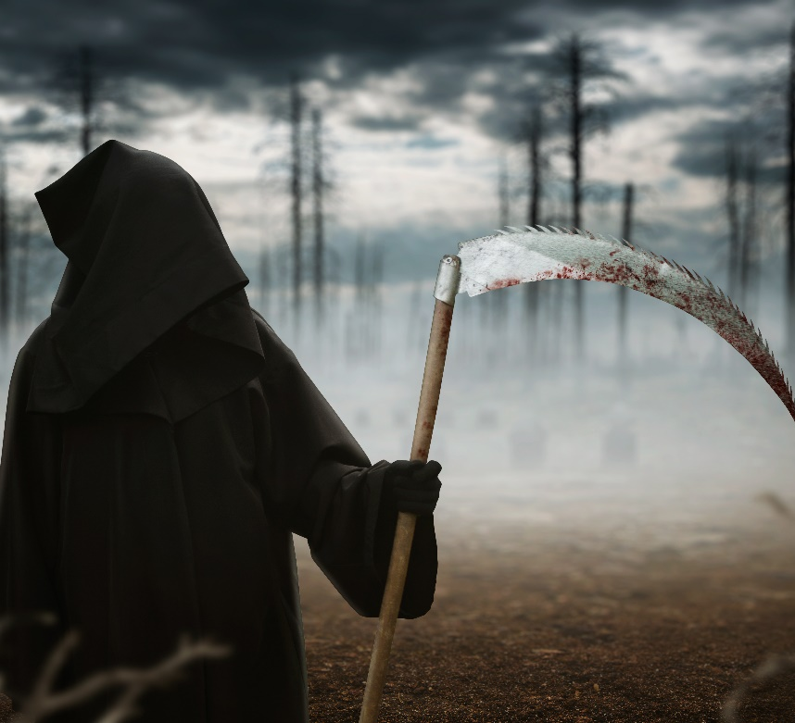

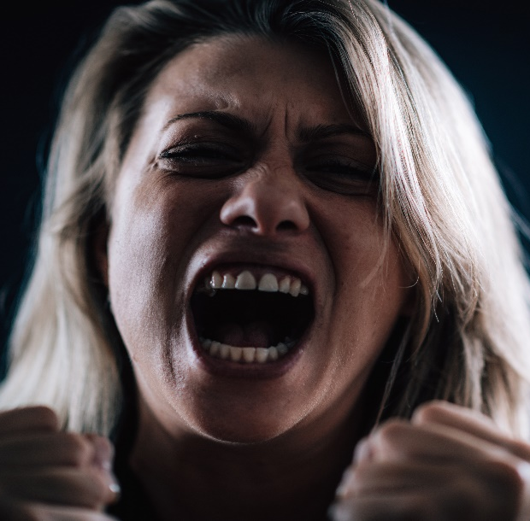
The sexual aggression distorts the ego development of psychic structures and interferes with the elaboration of aggression in fantasy as opposed to its direct expression in behaviour. The narcissistic grandiose self is established through aggression and fusion with a sadistic object. I am alone in my pain, rage, and fear, I will fuse with my tormentor and protect myself by destroying myself or my self-awareness (self-murdered). Inflicting pain and death onto others means . I don’t have to feel the pain again. Injustice gathering can be the easiest compromise.

Slide 8
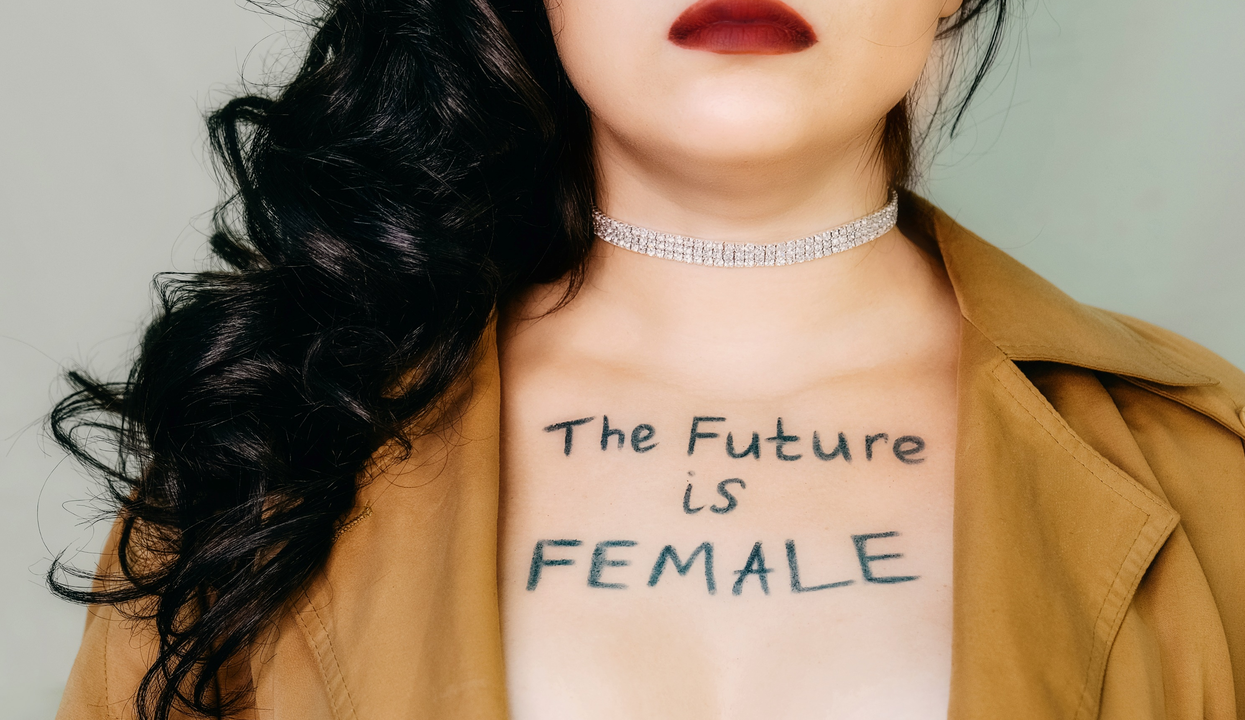
The feminist female is docile, led by chivalrous males, who she unconsciously envies and resents for the strength and power he wields, and she must depend on him. At the phallic stage of development, she wished to steal her father from the mother, with the mother becoming the hated obstacle which needs to be destroyed and removed. She harbours rage towards her mother, but because the death mother defeats her, she becomes over critical, overbearing and dictatorial.

Slide 9
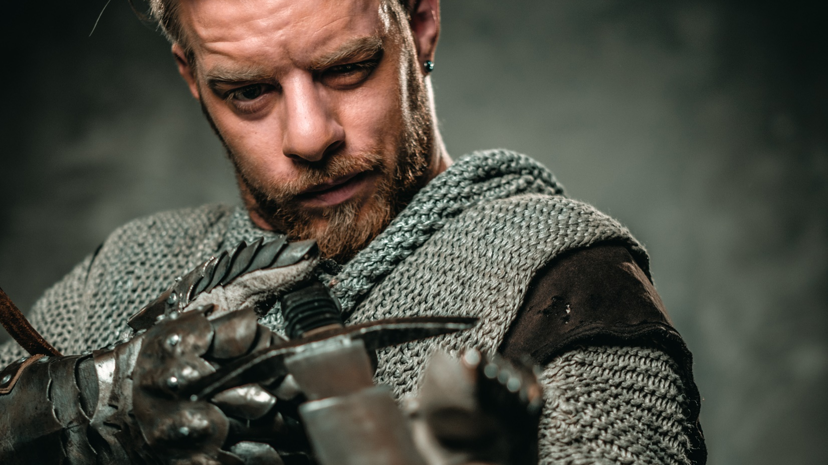
Chivalrous male
The chivalrous male seeks feminised females who adore him. He believes people envy his sexual prowess, but this underlying wish is not sex, but comfort, acknowledgement and pleasure. He turns to prescriptive drugs to mend what he believes is broken and medicate the problem away. Unable to be flexible and let go of beliefs and ideas, where he seeks familiarity and routine. Any sign of the authentic self will be curtailed and repressed.

Slide 10

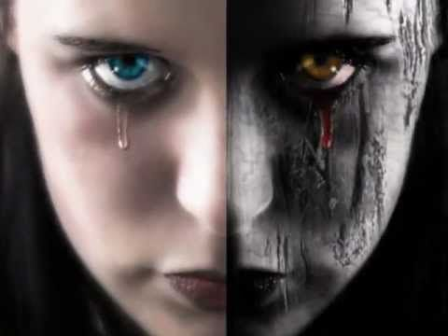
The woman can flourish, even in the patriarchal culture, psychologically underdeveloped, which would have caused the man to have failed and become neurotic. She remains hidden in women groups, the mother tribes, and maintains her continuity upward in relation to the group of mothers. Her solidarity with the proximity to woman and feminine coincide with her segregation and sense of alienation from men and the masculine. The husband, where there is a sexual relationship, remains a foreigner to the woman’s group and is large without the right of power or influence.

Slide 11


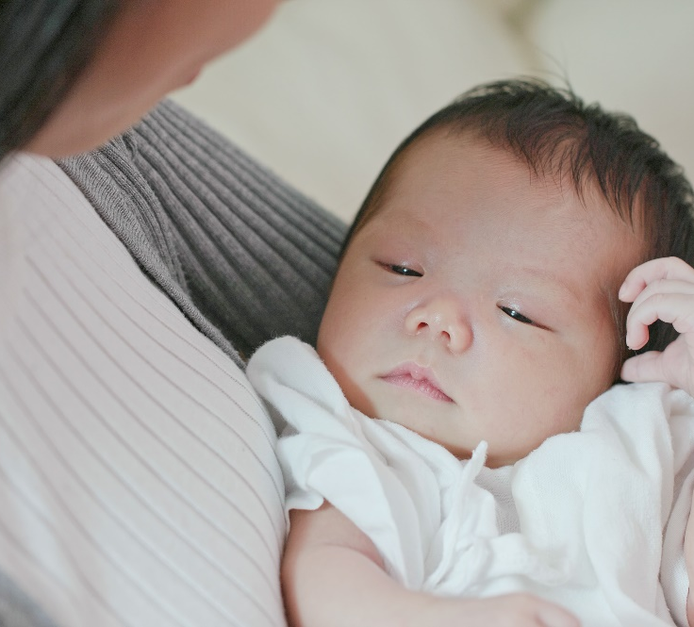
The married woman with children may stay unconscious with no self-awareness about life and about living with another person. Filled with her own unconscious notion about the masculine character and her husband, without having experienced herself as an ego or individual within the relationship. An inner hostility towards men makes intimacy and sexual relationships impossible. The male is loved as a child, but viewed only as a tool for fertility, but integrated as a subordinate to the feminine and the whole masculine is never acknowledged.

Slide 12
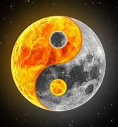
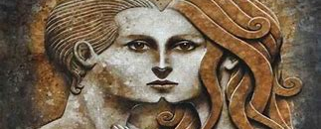
Unable to differentiate herself from this animus possession, she overdevelops her masculinity and surrenders to masculine power.
The liberation of the feminine from the powers of the patriarchal Uroboros is the task of the male hero, who must redeem the virgin from the dragon. The intervention of the male hero liberates her rigid consciousness and supports her spiritual and emotional development.

Slide 13
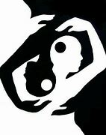
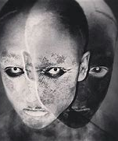

The patriarchal marriage is a way to prop up each other to achieve a cultural symbiosis, resulting in a polarisation between the masculine and feminine, with a false sense of security grounded within the family unit. The inflated male projects onto woman via aggression, status, and image, and in turn losses his soul.
He loves women in an infantile way, can be moody, unstable, and dependent as well as overbearing and insincere. His partner can turn into his mother, where he can only discharge his anger into the outer realms of politics and career goals. The male may seek homage in the collective, engrossed by the patriarchal values and belief, and his individuality fears are allayed.

Slide 14


The vital relationship between the tension of opposites, letting in the good and bad aspects of both the male and female. One may feel as though they are being held captive, as this phase holds major difficulties, where the problem with a relationship cannot differentiate from individuation problems. At the highest point of female development, her self-discovery encounters her masculine, where she experiences her inner maleness for the first time. The emergence of a higher image of self, the great mother, and the father are united.

Slide 15


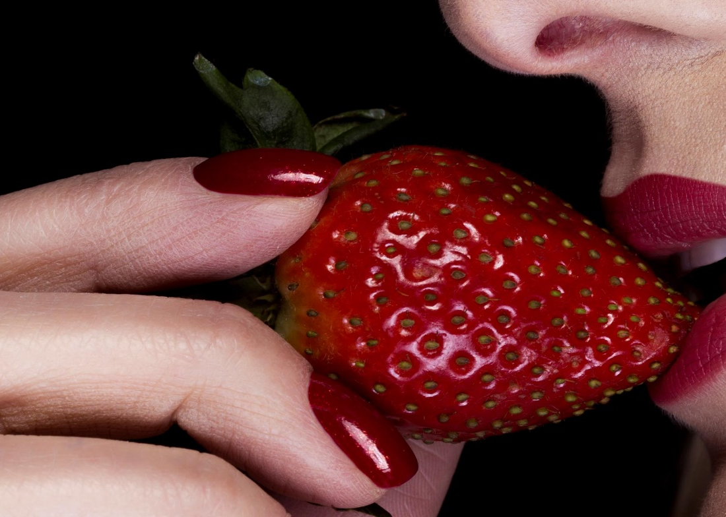
The child must commit a form of matricide, to kill their mother, the ego can slay what they hold most dear, the relationship to the idealised mother, under the guise of the dragon that holds the child fast. This deed of the ego comes with guilt feelings, which may prevent the slaying. Otherwise, the ego development is disturbed and has not attained independence, remains infantile due to his mother fixation. Unable to achieve the masculinity and power, the combative nature to slay the dragon.

Slide 16
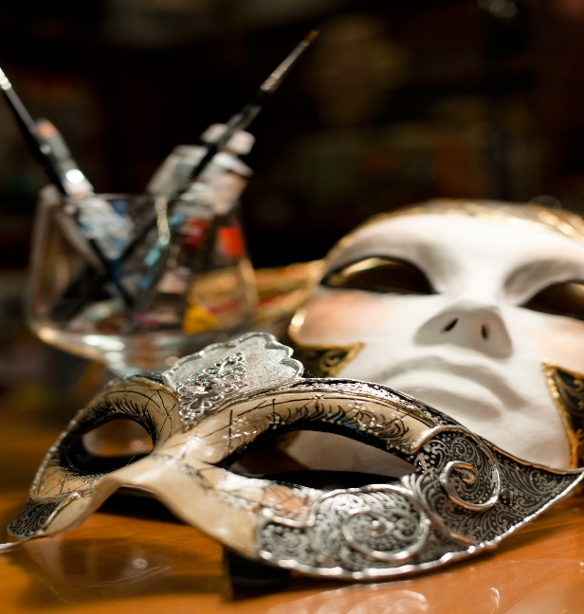


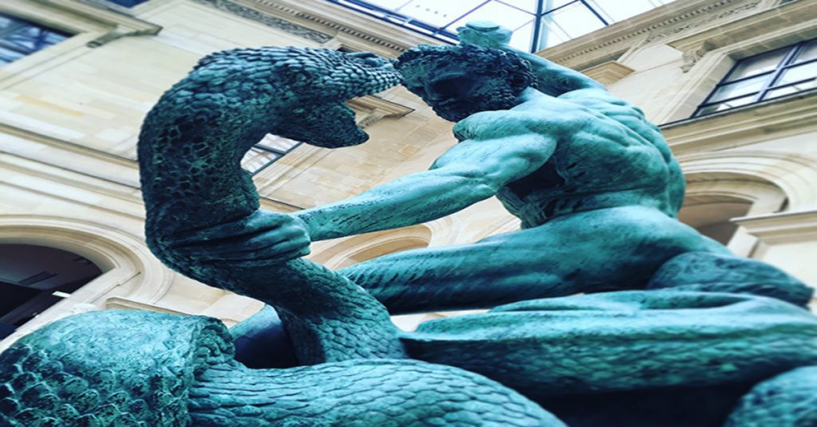
The normal adult attainment of individuation Is possible only through a severe crisis or illness. This forces one over the threshold, into the conquest and battle to slay the dragon, into the depth of the abyss. Inner and outer realities the first appeared as strange and frightening are now experienced and unmasked as belonging to one`s own true being
The ego experiencing belonging to the self, an ego-self axis, which determines the development of the personality at a higher level of expression. The ego becomes the transparent exponent of the self, the agent of transformation, as the self becomes one`s most treasured essence. Only during this process does courage arise for the ego, that no longer clings to itself, but though transformation surrenders and devotes itself to self.

Slide 17

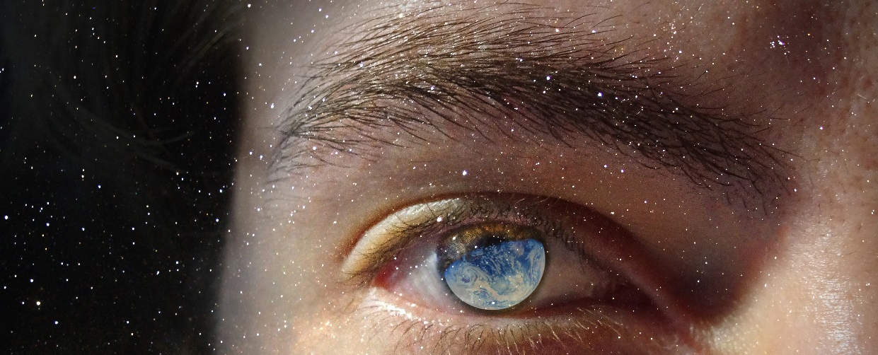
To enter heaven, the dragon of darkness must be challenged and destroyed. We need to integrate the anima and release a great cache of libido and Bioenergy. With more intellectual and emotional power, one can confront the dark side of the female psyche.
The journey of healing aims at unearthing the hidden parts of the Self to bring life back to the frozen aspects of the soul. This demands a long and in-depth examination of our own psyche. We must become our own mother and learn to love those parts of ourselves and accept that love, so we may come back to life and become whole.

Slide 18
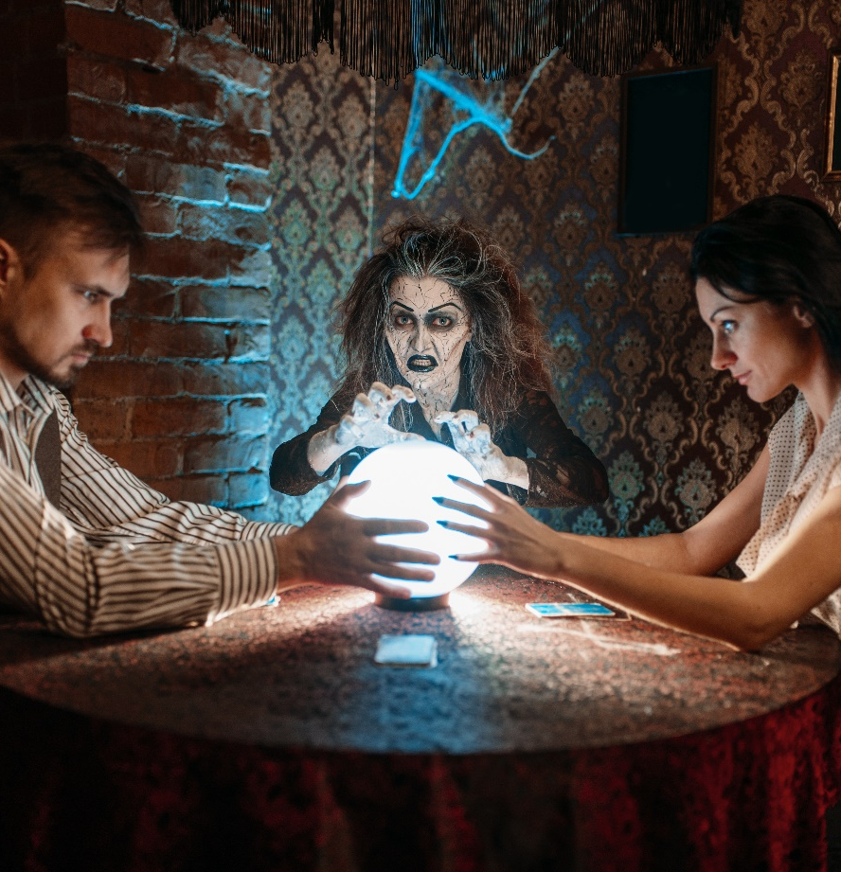
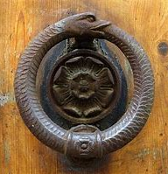
“Until you make the unconscious conscious, it will direct Your life, and you will call it fate."

Slide 19




WWW.CONJUNCTIO.CO.UK
EMAIL
KMARTIN1406@ZOHOMAIL.EU
07518-133742
01344-884708

